Slide 1

Advanced Studies School · Uberlândia
Numerical
Renormalization
Group
Jan 22 – Feb 1, 2019
Main lecturer: Prof. Rok Žitko
Jožef Stefan Institute, Ljubljana, Slovenia
warm-up lecture
Computational Tools
Prof. Gerson J. Ferreira
www.infis.ufu.br/~gerson
gersonjferreira@ufu.br
[ office: 1A-225 ]
http://www.infis.ufu.br/~escolanrg2019/

Slide 2
Outline
1) Intro to Linux and bash scrips (sed / grep / regex )
2) Introduction to python
→ code editors and overall syntax
3) Brief introduction to numpy and matplotlib
→ main features and commands
→ input/output
→ exercise: data smoothing
4) Data representation and multiple precision
→ Python: mpmath [ equiv. in C: GMP & MPFR ]
** see also my “book” on
Introduction to Computational Physics (with Julia)
http://www.infis.ufu.br/~gerson/

Slide 3
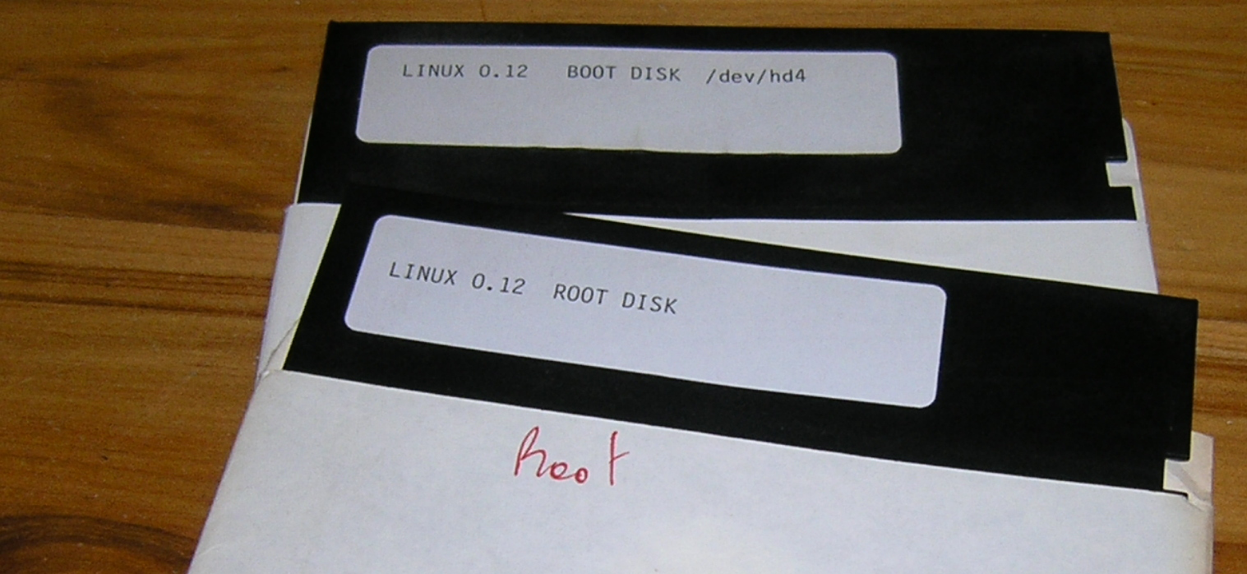
What is Linux?
“Microsoft isn't evil, they just make really crappy operating systems”
– Linus Torvalds (2013-01-29)

Slide 4
Some useful links
→ https://www.tutorialspoint.com/ ←
Linux tutorials: (includes bash, sed, awk, regex)
http://ryanstutorials.net/
https://linuxjourney.com/
http://www.grymoire.com/Unix
Bash script:
https://linuxconfig.org/bash-scripting-tutorial
http://tldp.org/HOWTO/Bash-Prog-Intro-HOWTO.html
http://matt.might.net/articles/bash-by-example/
Perl: https://www.tutorialspoint.com/perl/
Sed: http://www.grymoire.com/Unix/Sed.html
http://sed.sourceforge.net/sed1line.txt
https://www.tutorialspoint.com/unix/unix-regular-expressions.htm
Awk: https://likegeeks.com/awk-command/
Regular expressions (regex): https://regexone.com/
https://regex101.com/
https://medium.com/factory-mind/regex-tutorial-a-simple-cheatsheet-by-examples-649dc1c3f285

Slide 5
UNIX filosofy: minimalism!
→ Doug McIlroy (1978), Peter H. Salus (1994)
Software must...
... perform a single task!
→ and do it efficiently
... work together
→ communication via I/O (fs, text, pipes)
...use the shell to combine commands
→ and perform complex tasks
GNU, Free Software Fundation
→ R. Stallman (1983)
→ promotes the universal freedom to study, distribute, create, and modify computer software

Slide 6
Hello everybody out there using minix - 25/agosto/1991
I'm doing a (free) operating system (just a hobby, won't be big and professional like gnu) for 386(486) AT clones. This has been brewing since april, and is starting to get ready. I'd like any feedback on things people like/dislike in minix, as my OS resembles it somewhat (same physical layout of the file-system (due to practical reasons) among other things).
I've currently ported bash(1.08) and gcc(1.40), and things seem to work. This implies that I'll get something practical within a few months, and I'd like to know what features most people would want. Any suggestions are welcome, but I won't promise I'll implement them :-)
Linus (torv...@kruuna.helsinki.fi)
PS. To make things really clear - yes I can run gcc on it, and bash, and most of the gnu [bin/file] utilities, but it's not very debugged, and the library is really minimal. It doesn't even support floppy-disks yet. It won't be ready for distribution for a couple of months. Even then it probably won't be able to do much more than minix, and much less in some respects. It will be free though (probably under gnu-license or similar)

Slide 7
BASH - Bourne-Again SHell
.88888888:.
88888888.88888.
.8888888888888888.
888888888888888888
88' _`88'_ `88888
88 88 88 88 88888
88_88_::_88_:88888
88:::,::,:::::8888
88`:::::::::'`8888
.88 `::::' 8:88.
8888 `8:888.
.8888' `888888.
.8888:.. .::. ...:'8888888:.
.8888.' :' `'::`88:88888
.8888 ' `.888:8888.
888:8 . 888:88888
.888:88 .: 888:88888:
8888888. :: 88:888888
`.::.888. :: .88888888
.::::::.888. :: :::`8888'.:.
::::::::::.888 ' .::::::::::::
::::::::::::.8 ' .:8::::::::::::.
.::::::::::::::. .:888:::::::::::::
:::::::::::::::88:.__..:88888:::::::::::'
`'.:::::::::::88888888888.88:::::::::'
`':::_:' -- '' -'-' `':_::::'`

Slide 8
Moving around
→ Open the terminal (bash), to access the command prompt ($)
→ It opens at the users $HOME folder.
→ check where you are by running $ pwd
→ this is your folder (user/group)
→ run $ ls to list the files at your $HOME
→ but there can be hidden files: run $ ls -a
→ files that start with . are “hidden” (config files)
→ Let’s go to /var/log
$ cd /var/log
$ pwd
$ ls
→ Special characters and relative path:
.. refers to the parent folder. Run $ cd .. and $ pwd
~ is a shortcut to $HOME. Run $ cd ~ and $ pwd
. is the current folder. Useful to copy files, etc…
example: $ cp /etc/ssh/ssh_config .
→ Tip:
Use TAB to autocomplete commands and file names

Slide 9
Complex file names
→ File names are case senstive
→ Avoid unsual characters !@#$&*
→ It is better to use only
letters [a..z]
numbers [0..9] and
simple symbols - _ .
→ extensions (.txt, .dat, .png) are optional, only for organization
→ Spaces are allowed, but be careful:
Try it:
$ mkdir Folder with long name
$ ls -l
$ mkdir “Better use quotes”
$ ls -l
$ mkdir This\ slash\ notation\ is\ terrible
$ ls -l

Slide 10

System tree
/ – system root
/home – home folders for all normal users
/media – external devices (pendrive, cd, floppy??, ...)
/etc – system config files and init scripts
/dev – devices… within Linux, everything is a file
/var – system logs, caches
/usr – main folder for installed software
/bin – core binary files
/sbin – system binary files (config, admin)
/root – superuser home folder
/lib – libraries
/boot – kernel and boot (grub, efi, ...)
/mnt – aux folder for devices or external mounts
/opt – aux folder to store extra softwares
/proc – system and processes information
/tmp – temporary files
...

Slide 11
Permissions
→ Categories
u = user, g = group, o = others
Who are you? Who, who, who, who? Run: $ whoami and $ groups
→ Let’s create a file and check its permissions:
$ echo “Write something creative here” > myfile.txt
$ ls -l
total 32K
-rw-rw-r-- 1 gerson users 18 Set 24 15:44 myfile.txt
drwxr-xr-x 2 gerson users 4,0K Set 22 11:03 Desktop
drwxr-xr-x 5 gerson users 4,0K Set 23 18:59 Documents
drwxr-xr-x 5 gerson users 4,0K Set 24 15:24 Downloads
drwx------ 35 gerson users 4,0K Set 22 09:02 Dropbox
drwxr-xr-x 8 gerson users 4,0K Set 9 07:57 public_html
drwx------ 16 gerson users 4,0K Jul 21 22:25 Sync
drwxrwxr-x 4 gerson users 4,0K Set 21 20:45 tmp
permissions
user
&
group
last
modification
date
file name
or
folder
# links
size

Slide 12
Permissions
-rw-rw-r-- 1 gerson gerson 18 Set 24 15:44 myfile.txt
drwx------ 35 gerson gerson 4,0K Set 22 09:02 Dropbox
drwxr-xr-x 8 gerson gerson 4,0K Set 9 07:57 public_html
→ read it as: d | rwx | r-x | r-x
u g o
→ First field:
“d” indicates a directory/folder
“-” indicates a file
→ Other fields refer to the user/group/others permissions
“r” permission to read
“w” permission to write/modify/delete
“x” permission to run (exec)
→ Changing permissions
$ chmod go-rw myfile.txt ← removes(–) rw from g and o
→ Changing the ownership
$ chown root:gerson myfile.txt ← owner=root, group=gerson

Slide 13
Man pages
→ We’ll go through many commands
→ To check the details on how to use each command...
read the manual!! ;-)
$ man man (read the manual on how to use the manual)
→ to navigate: arrows
→ to search: / , n (next)
→ to quite: q
→ help: h
Example:
$ man grep
→ search por “case”
→ check also the command whatis:
$ whatis cp
$ whatis grep

Slide 14
Files: creating/removing/copying/...
→ Create a blank file
$ touch blank.txt
$ ls -l
→ Create some folders
$ mkdir My_Files Another_Folder
→ Move blank.txt to My_Files
$ mv blank.txt My_Files
$ ls My_Files
→ Renaming files or folders is the same as moving
$ mv My_Files New_Name
$ ls
→ Using relative paths:
$ cd Another_Folder
$ mv ../New_Name .
→ Let’s delete all files and folders we have created here
$ rm <file1> <file2> …
$ rmdir <dir1> <dir2> …

Slide 15
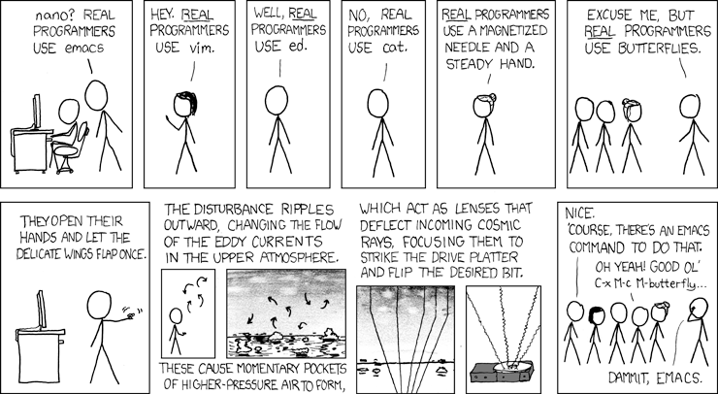
File editors
→ Main editors: vim, emacs
... both complicated, both powerful!!
Real programmers set the universal constants at the start such that the universe evolves to contain the disk with the data they want.

Slide 16
File editors
minimalist set of commands
emacs
vim
$ emacs myfile.txt
Save → CTRL+x CTRL+s
Quit → CTRL+x CTRL+c
Abort → CTRL+g
More:
https://www.gnu.org/software/emacs/refcards/pdf/refcard.pdf
$ vim myfile.txt
Edit → i
Commands → ESC
Save → :w
Quit → :q
Force → :q!
More:
http://tnerual.eriogerg.free.fr/vimqrc.pdf
nano
gedit
$ nano myfile.txt
Save → CTRL+o
Quit → CTRL+x
$ gedit myfile.txt
(graphical interface)

Slide 17
Quickly reading files
→ cat (tac) prints (stnirp) the file on screen:
$ cat myfile.txt
→ less: show file interactively
$ less myfile.txt (arrows, /=search, h=help, q=quit)
→ head -n 3 myfile.txt : prints the first 3 lines
→ tail -n 3 myfile.txt : prints the last 3 lines
→ grep: prints lines that match a pattern (see regex)
Try it:
$ grep --color Nobel nrg.txt

Slide 18
Input / output redirect
$ command > file.txt : redirect output to file
$ command >> file.txt : append into file
$ command 1> file.txt 2> errors.txt
redirects main output to file.txt
error output to errors.txt
$ command_1 | command_2 : |=pipe captures output from 1
and redirects as the input of 2
Examples (check the commands without redirection as well)
$ echo “Hello world” > hello.txt
$ ls -l
$ cat hello.txt
$ echo “one more line” >> hello.txt
$ cat hello.txt
$ ls / | grep bin
$ ps -ef | grep bash

Slide 19
Scripts
→ Scripts start with #! = hash(#) bang(!) = hashbang
Indicates the language, which must work with pipes |
→ bash: #!/bin/bash
→ gnuplot: #!/usr/bin/gnuplot
→ python: #!/usr/bin/python3
→ perl: #!/usr/bin/perl
Examples:
→ Edit hello.sh, and give it permission to run $ chmod +x hello.sh
→ To run, call $ ./hello.sh
#!/bin/bash
myname=`whoami`
echo "Hello world! My name is $myname."
→ Now in Perl:
#!/usr/bin/perl
$myname=`whoami`;
print("Hello world! My name is $myname.\n");

Slide 20
Gnuplot example
see http://gnuplot.sourceforge.net/demo/
my old gnuplot class in www.infis.ufu.br/~gerson
→ Example 1: plot on screen
#!/usr/bin/gnuplot --persist
set xlabel('T')
set ylabel('S_z')
# from file termo.dat, plot using x = column 1, y=column 2
# with lines and points and point type = circles (7)
plot 'termo.dat' u 1:2 w lp pt 7
→ Example 2: plot to file
#!/usr/bin/gnuplot --persist
set terminal png size 800,600 nocrop
set output "gpfigure.png"
set xlabel('T')
set ylabel('S_z')
plot 'termo.dat' u 1:2 w lp pt 7

Slide 21
Scripts
→ good scripts require knowledge of the linux commands
#! – hashbang, first line, defines the language
cd – change directory
ls – list content of directory
pwd – print working directory
mkdir – make directory
rm – remove / delete
rmdir – remove / delete folders (directories)
mv – move / rename
cat – print file on screen (see tac as well)
echo – print text or variables on screen
less – show file on screen interactivelly
grep – capture lines accordingly to pattern (see regex)
kill – signals a process, usually to kill it
redirecting: > (write) >> (append) < (read) | (pipe)

Slide 22
Scripts
→ many… many useful commands (all work with files or pipes)
head – print the first lines
tail – print the last lines
sort – sort lines (check $ man sort)
nl – count number of lines
wc – count characters, words, paragraphs...
cut – cut sections
paste – merge sections
join – join lines
uniq – remove repeated lines
tr – translate or delete characters
egrep – grep + regular expressions (regex)
regex – advanced pattern matching
sed – stream editor to transform / manipulate text
awk – pattern processing language
...

Slide 23
Example: simple backup
→ Create backup.sh:
#!/bin/bash
# save backup to
bakdir="$HOME/backup"
echo "Backup directory: $bakdir"
# creates folder if necessary
mkdir -p $bakdir
# today’s date on ISO8601 format YYYY-MM-DD
today=`date -I`
# backup file name
fname="$bakdir/$hoje.tgz"
# compacts the current directory and save it
# in the backup folder
tar -czf $fname ./*

Slide 24
Example: special vars
→ Edit args.sh:
#!/bin/bash
echo "Script name: $0"
echo "Number of parameters: $#"
echo "Parameter array: $@"
id=1
for par in $@; do
echo "Parameter $id = $par"
let id++
done
→ Arithmetic operations in bash require
(i) the macro let
let id++
let id=id+1
(ii) or the double parenthesis:
(( id++ ))
id=$((id+1))
(( id=id+1 ))

Slide 25
Examples: cut and paste columns
→ Edit cutpaste.sh:
#!/bin/bash
# using redirect to merge one under the other
files=`ls file*.txt`
new="merged.txt"
echo -n "" > $new
for eachfile in $file; do
cat $eachfile >> $new
done
→ run these directly on bash
# merge all columns side by side
paste -d ' ' file1.txt file2.txt > pasted.txt
# extracts some columns
cut -d ' ' -f 1,3 pasted.txt > cut.txt
# equivalently:
paste -d ' ' file1.txt file2.txt | cut -d ' ' -f 1,3 > cut2.txt

Slide 26
Using sed
→ Check the file Linux_win.txt. Clearly wrong! Let’s fix it!
→ Replace first occurrence on each paragraph
$ sed 's/windows/linux/' Linux_win.txt
→ Replace n-st occurence in each paragraph
$ sed 's/windows/linux/2' Linux_win.txt
→ Replace all occurences
$ sed 's/windows/linux/g' Linux_win.txt
→ Run and try to explain these commands to me:
check $ man sed if necessary
$ sed 's/windows/!&?!/g' Linux_win.txt ← try also with &&
$ sed -i 's/windows/{aux}/g; s/linux/windows/g;
s/{aux}/linux/g' Linux_win.txt
→ great! now it looks good!!

Slide 27
Regular expressions (regex)
Can be used with bash, perl, python, C, …
Let’s use the file cordel.txt in our examples:
# print lines that contain ‘capaz’
grep --color capaz cordel.txt
# print lines that start (^) with ‘Eu’
grep --color ^Eu cordel.txt
# print lines that end ($) with ‘;’ (special character)
grep --color \;$ cordel.txt
# print lines that cotain ‘sã’ or ‘nã’
grep --color [sn]ã cordel.txt
# print lines that start with A, B, C, D
grep --color ^[A-D] cordel.txt
...

Slide 28
Introduction to Python
Overall syntax and Code editors

Slide 29





Python Code Editors: my favorites
+ Hydrogen package
[www.atom.io]
[www.nteract.io]
new!
[www.jupyter.org]
JupyterLab
[https://github.com/jupyterlab/jupyterlab]

Slide 30

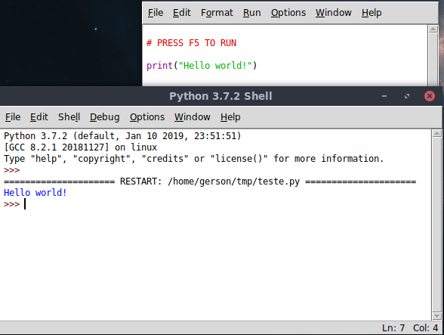
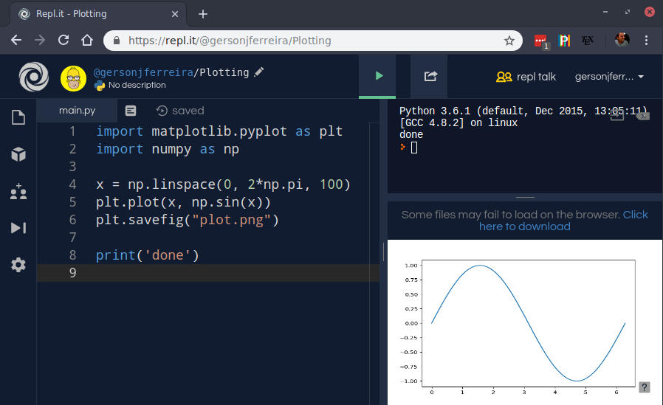
Python Code Editors: available in this class
IDLE: simple, but useful
→ make sure to open the Python 3 version!
Online: www.repl.it

Slide 31
Python tutorial
[https://www.w3schools.com/python/python_intro.asp]

Slide 32
Python: basic operations
1) Assignment
2) if statement
a = 3
b = 4
c = a**2 + b**2
print(‘c = ‘, c)
if a > b:
print(‘a is larger than b’)
elif a < b:
print(‘b is larger than a’)
else:
print(‘a is equal to b’)
3) types of variables
4) operators
x = 5 # int
y = 4.2 # float
Na = 6.022e23 # float
z = 3 + 4j # complex
a = ‘hello’ # string
print(type(z))
...
Arithmetic: + , - , * , /
Exponentiation: ** ,
ex: 1024 == 2**10
Assignment: = , += , -= , *= , /=
ex: x *= 3 → x = x*3
Comparison: ==, !=, >, >=, <, <=
Logical: and , or , not
Membership: in , not in
ex: 5 in [3, 2, 9] → False

Slide 33
Python: basic operations
5) Lists (for vectors → see numpy)
8) Lists over range of integers
fruits = [‘banana’, ‘orange’]
fruits.append(‘apple’)
fruits.sort()
print(‘Length:’, len(fruits))
print(‘first:’, fruits[0])
print(‘last:’, fruits[-1])
syntax:
range(n) → 0,1,..n-1
range(i, f, s)
i → initial
f → final, not included
s → step
for i in range(3, 15, 2):
print(i)
for i in range(len(fruits)):
print(i, fruits[i])
6) For loop over lists
for fruit in fruits:
print(‘we have ’, fruit)
7) Membership
if ‘grape’ in fruits:
print(‘yes, we have grapes’)
else:
print(‘no, we don’t have grapes’)

Slide 34
Python: basic operations
9) Functions
10) Lambda inline functions
# import single function
# from the math library
from math import sqrt
# define the function
# here c has a default value
def bhaskara(a, b, c=0):
d = sqrt(0j+b**2-4*a*c)
x1 = (-b+d)/(2*a)
x2 = (-b-d)/(2*a)
return x1, x2
# calling the function
s1, s2 = bhaskara(1, -5, 6)
print(‘sols:’, s1, ‘and‘, s2)
# check with bhaskara(1, -5, 0)
from math import exp, sin
# short function can be written
# in a compact notation
sinc = lambda x: sin(x)/x
gauss = lambda x: exp(-x**2)
y = sinc(1.0)*gauss(3.0)
print(‘y = ‘, y)

Slide 35
Python: basic operations
11) Libraries
# to import a single function
from math import sqrt
print(sqrt(2))
help(sqrt) # help only works with imported objects
# to import everything
# not recommended → possible conflicts
from math import *
print(cos(pi))
# import under a short name
import math as m
print(m.sin(m.pi/2))
help(m)
Instead of the math library, we will typically prefer to use numpy:
→ includes math, num. calculus,
linear algebra, ...
import numpy as np
print(np.cos(np.pi))

Slide 36
Python: basic operations
→ Comprehensions : simple form to create lists and matrices (+ numpy)
mylist = np.array([ f(x) for x in xlist ])
Nested lists form matrices:
mymatrix = np.array([ [g(x,y) for x in xlist] for y in ylist ])
→ Dictionaries : very useful to store/organize input parameters
params = {}
params[‘temperature’] = 300
params[‘mag. field’] = 10
params[‘method’] = ‘RK4’
print(params)
print(‘T = ‘, params[‘temperature’])

Slide 37
Exercise: factorial
- Create a function called “myfactorial” that receives a number n and returns the factorial n!.
- Do not use recursive functions! Implement the factorial using a for loop.
- Compare the result with the native factorial function from the math library.
- Test it with the code below:
from math import factorial
def … # implement your function here
# testing:
n = 10
print(‘Exact: ‘, factorial(n))
print(‘Mine: ‘, myfactorial(n))
Answer:
CENSORED
def myfactorial(n):
f = 1
for i in range(1, n+1):
f *= i
return f
Expected result: 3628800

Slide 38
Intro to numpy and matplotlib
reading/saving files, manipulating data, plotting
[https://www.tutorialspoint.com/numpy/index.htm]
[https://www.tutorialspoint.com/python/python_matplotlib.htm]

Slide 39
Python + numpy : vector-based language
The main element in numpy are the nd-arrays (nd = n-dimensional)
→ vectors
[ = vector/matrix/tensor ]
import numpy as np
v1 = np.array([7, 4, 9, 10]) # 4-component vector
v2 = np.linspace(5, 12, 4) # (initial, final*, step)
print(‘v1 = ‘, v1, ‘, v2 = ‘, v2)
d = np.dot(v1, v2) # nd-scalar product
print(‘scalar product = ‘, d)
x = np.array([1, 0, 0])
y = np.array([0, 1, 0])
z = np.cross(x, y) # cross product only for 2D and 3D arrays
print(‘z = ‘, z)

Slide 40
Python + numpy : vector-based language
→ matrices
import numpy as np
mat1 = np.array([ [1,2] , [3,4] ]) # a 2x2 matrix
line1 = np.array([1,2]) # each line is a vector
line2 = np.array([3,4])
mat2 = np.array([ line1, line2 ]) # another way to write mat1
print(‘matrix 1 = ‘, mat1)
print(‘matrix 2 = ‘, mat2)

Slide 41
Python + numpy : vector and matrix operations
vectors
matrices
v1 = np.array([1,2,3])
v2 = np.array([4,5,6])
print(v1+v2)
print(v1*v2)
print(v1**2)
print(np.sin(v1*np.pi))
v3 = np.zeros(5)
v4 = np.ones(5)
print(v3)
print(v4)
m0 = np.zeros((5,5))
m1 = 2*np.diag(np.ones(5))
m2 = -np.diag(np.ones(4), +1)
m3 = -np.diag(np.ones(4), -1)
m4 = m1 + m2 + m3
print(m4) # Exercise: explain the commands
v0 = np.array([1, -1, 0, 1, -1])
print(m4*v0) # what is the difference
print(np.dot(m4, v0)) # between these two?

Slide 42
Python + numpy : vector and matrix elements
→ array indexes start from 0
vectors
v1 = np.array([6, 3, 4, 2])
print(v1[0]) # to access an specific element
print(v1[-3]) # can count backwards, -1=end, and so on
v1[-3] = 5 # or change its value
print(v1)
print(v1[1:3]) # open interval (i:f(
print(v1[:3]) # i=0 if omitted
print(v1[1:]) # f=-1 if omitted
print(v1[0:-2]) # counting backwards

Slide 43
Python + numpy : vector and matrix elements
matrices
m1 = np.array([[1, 2, 3], [4, 5, 6], [7, 8, 9]])
print(m1)
print(m1[1,2])
# line 1, column 2 : recalling that starts from 0
print(m1[:,2])
# [:,2] = [0:-1,2] = all lines, column 2
print(m1[1,:]) # line 1, all columns
print(m1[1:, 1:]) # extracting a submatrix

Slide 44
Python + numpy : linspace vs arange
Important, similar, and confusing ways of defining a discrete axis
x
a
b
np.linspace
np.arange
(initial, final, number of points)
(initial, final*, step)
a = 5 # initial point
b = 11 # final point
N = 4 # number of points
x = np.linspace(a, b, N)
print(x)
dx = x[1]-x[0]
a = 5 # initial point
b = 11 # final* point
dx = 2 # step size
x = np.arange(a, b+dx/2, dx)
print(x)
N = len(x)
* open interval

Slide 45
Matplotlib: simple plots
Let’s start with some basic plots
import numpy as np
import matplotlib.pyplot as plt # standard call
plt.rc('font', size=22) # overall font size
k_rng = np.linspace(-50, 50, 100) # elements ( k[i], ek[i] )
ek_rng = 0.5*k**2 # form ordered pairs for the plot
plt.figure(figsize=(6,4)) # figure size in inches [1 in = 2.54 cm ]
# x y
plt.plot(k_rng, ek_rng, lw=3, color=’red’)
plt.xlabel(R‘$k$’) # R indicates Latex
plt.ylabel(R’$\varepsilon(k)$’)
plt.tight_layout() # recenter figure to the visible window
plt.savefig(‘parabola.png’) # relative to running path
plt.show() # to show on screen

Slide 46
Python + numpy : input / output
Check the file termo.dat → 8 columns
import numpy as np
import matplotlib.pyplot as plt
plt.rc('font', size=22)
data = np.loadtxt('termo.dat') # read and store as nd-array
print('lines and cols = ', data.shape)
plt.plot(data[:,0], data[:,1]) # x=col 0, y=col 1
plt.xlabel(R'$T$')
plt.ylabel(R'$\langle S_z^2 \rangle$')
plt.tight_layout()
plt.show()
→

Slide 47
Python + numpy : input / output
To save data in a N-columns data file, organize it as a matrix.
import numpy as np
theta = np.linspace(0, 2*np.pi, 13)
sin = np.sin(theta)
cos = np.cos(theta)
tosave = np.array([theta, sin, cos]) # lines
print(‘shape = ‘, tosave.shape)
tosave = np.array([theta, sin, cos]).T # transpose to columns
print(‘shape = ‘, tosave.shape)
np.savetxt(‘out.dat’, tosave)
→
→

Slide 48



Exercise: 1D density of states ↔ data smoothing
From Solid State Physics:
such that →
If we know the dispersion exactly :
van-Hove sing.
we can proceed to obtain :
But instead, let us replace delta → gaussian, and sum numerically

Slide 49
Exercise: 1D density of states
1) From the matplotlib example, we already have
k → k_rng, and ε_{k} → ek_rng
2) From k_rng, calculate Δk (see linspace)
3) Define a function gauss(ε, s), following the Gaussian definition above
→ later we will use s → σ=10
4) Use linspace to define an energy range from -50 to 1000 with 1000 points
5) Initialize a variable dos using np.zeros(…) with the same number of points
6) Loop over ek_rng to sum the dos, and plot D(ε) vs ε. Result → next slide

Slide 50
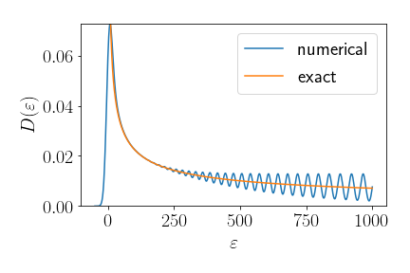
Exercise: 1D density of states
7) Try to plot the final figure like this one
→ Why are there oscillations?
→ Try increasing the number of
points in k_rng
→ Code will be available after the class

Slide 51
Numerical calculus and linear algebra
Simple examples on how to use numpy / lapack

Slide 52
The numpy & scipy libraries
main libraries for scientific computing in Python
import numpy as np
import scipy as sp
Main features:
→ ND Arrays = vectors, matrices, tensors
→ Linear Algebra = matrix/vector products,
eigenproblems (LAPACK), decompositions, …
→ Fast Fourier Transforms (FFT)
→ Input / output
→ Special functions
→ Integration, differential equations, Runge-Kutta, ...
→ Interpolation
→ Symbolic mathematics

Slide 53
Eigenproblem example: infinite quantum well
The discrete kinetic energy is
-2 1 0
1 -2 1 0
0 1 -2 1 0
0 1 -2 1
0 1 2
Let’s calculate its eigenvalues and eigenvectors
import numpy as np
import matplotlib.pyplot as plt
N = 15 # size of the matrix, well length
Hk = -2*np.diag(np.ones(N)) # diagonal
Hk += np.diag(np.ones(N-1), +1) # top subdiagonal
Hk += np.diag(np.ones(N-1), -1) # lower subdiagonal
Hk *= -1/2 # common prefactor
evals, evecs = np.linalg.eigh(Hk)
print(‘Energies: ‘, evals[0:3]) # first 3 energies
# trick to add the outer points (boundary condition, psi=0)
evecs_bc = np.vstack([np.zeros(N), evecs, np.zeros(N)])
plt.plot(evecs_bc[:, 0:3]) # plot first three psi
plt.show()
→

Slide 54
Data representation
Floating-point numbers and multiple-precision

Slide 55
Data representation
Real numbers
Example of exact representations:
significand x base ^{exponent}
Integers
42 : what is the meaning of all this?
how does the computer store these numbers?
what are the limitations?

Slide 56

8-bits, 16-bits, 32-bits, 64-bits, 128-bits ... ?
(nes, snes, ps, n64, ps2, xbox, … ;-)
Each CPU implements native n-bits operations [ current PCs: 64-bits ]
Example: it limits the memory allocation and data representation
A 3-bit memory controller
can only point to 2³ = 8 addresses
A 3-bit memory bank
can only represent 8 abstract entities
000
000 = apple
001
7
001 = avocado
1
010
9?
010 = banana
3
011
4
011 = lemon
2
8
orange?
100
100 = pineapple
101
6
5
101 = strawberry
110
110 = kiwi
111
111 = grape

Slide 57
Integer representation
From the previous slide, a 3-bit computer can only represent 8 integers
3-bit binary memory
1
0
1
= 1x2² + 0x2¹ + 1x2⁰ = 5
2
1
0
Min: (000)b = 0
Max: (111)b = 7
Signed 32-bit integer standard
…
Range 9+ digits
1
1
1
1
1
1
1
1
Min: -2³¹ = -2,147,483,648
Max: +2³¹-1 = +2,147,483,647
+ 31-bits
“2's complement representation”
Sign +/-
= (-1)^{b31} x (b₃₀ x 2³⁰ + b₂₉ x 2²⁹ + … b₀ x 2⁰)
“sign-magnitude representation”

Slide 58
Real numbers : floating point
significand x base ^{exponent}
Signed 32-bit float standard
1
1
1
1
1
1
1
1
1
1
1
1
1
1
1
1
1
1
1
1
1
1
1
1
1
1
1
1
1
1
1
1
exponent (8 bits)
= signed int
|significand| (23 bits)
sign of the significand
x
While the set of real numbers is dense / continuous...
only a limited number of entities can be represented on a finite structure
→ loss of precision

Slide 59
Comparing real numbers
Let us try this in Python
1) initialize the variables as
2) check the output of the equality tests
x = 0.1
y = 3*x
z = 0.3
z == 0.3
z == y
z == 3*0.1
3) What is happening? Let us print x, y, z with many digits
print(‘x = ‘, format(x, ‘0.30f’))
print(‘y = ‘, format(y, ‘0.30f’))
print(‘z = ‘, format(z, ‘0.30f’))

Slide 60
Why is 0.1 = 0.100000000000000005551115123126 ?
If a float in simply stored as significand x base ^{exponent}
shouldn’t we have 0.1 = 1 x 10⁻¹ ?
… but computers use base 2 !!!
Examples
→ the fraction 1/10 in base 10 is 0.1 (exact)
→ the fraction 1/3 in base 10 is 0.3 = 0.333333… ~ 0.333334
→ the fraction 1/10 in base 2 is 0.00011 = 0.00011001100110011…
An exact fraction in base 10 might be a repeating fraction in base 2
Truncation yields: (0.0001100110011)₂ = (0.0999755859375)₁₀
To convert from decimal to binary: [https://www.rapidtables.com/convert/number/binary-to-decimal.html]

Slide 61
Multiple, or arbitrary-precision
Default types:
Allows you to freely choose the precision
Floats: 32 bits ~ 7 digits, 64 bits ~ 16 digits, 128 bits ~ 34 digits
C
[int] = 32 bits
[float] = 32 bits
[double] = 64 bits
…
GMP: GNU Multiple Precision Arithmetic Library
[https://gmplib.org/]
MPFR: multiple-precision floating-point computations
with correct rounding
[https://www.mpfr.org/]
Python
[int] = arbitrary
[float] = 64 bits
Python mpmath
[http://mpmath.org/]
→ for multiple-precision in Python, uses GMP if available
Python SymPy
[https://www.sympy.org/]
→ for Symbolic mathematics in Python

Slide 62
Example in Python
From “Why and How to Use Arbitrary Precision”,
Ghazi et al, Computing in Science & Engineering 12, 62-65 (2010)
Let us try to calculate d = 173746a + 94228b − 78487c, with
a = sin(10²²), b = log₁₀(17.1), c = exp(0.42)
Standard Python
import numpy as np
a = np.sin(1e22)
b = np.log(17.1)
c = np.exp(0.42)
d = 173746*a + 94228*b - 78487*c
print(‘d =‘, d)
2.9103830456733704e-11
Exact value:
−1.341818958... x 10⁻¹²

Slide 63
The same Python example, but using mpmath
from mpmath import mp
mp.dps = 40 # defines the decimal precision
print(mp) # to check again
a = mp.sin(‘1e22’)
b = mp.log(‘17.1’)
c = mp.exp(‘0.42’)
d = 173746*a + 94228*b - 78487*c
print(‘d = ‘, d)
-1.34181895782961046706215258814e-12
Exact value:
−1.341818958... x 10⁻¹²
Notice that the real numbers are set by strings, otherwise Python would first convert to floating-point and lose precision. TRY IT!

Slide 64
Overall features of these libraries
python
numpy+scipy
python
mpmath
C+GMP+MPFR
Float precision
64 bits
arbitrary
arbitrary
Trigonometric functions
+
Special functions
np.sin(…)
np.exp(…)
sp.special.jv(…)
sp.special.zeta(…)
mp.sin(…)
mp.exp(…)
mp.besselj(…)
mp.zeta(…)
mpfr_sin(…)
mpfr_exp(…)
mpfr_jn(…)
mpfr_zeta(…)
Root finding, sum, quadrature (integrals), differentiation, ODE (RK4), Taylor, Fourier, ...
Numerical calculus
Check other libraries:
GSL
mpack = blas+lapack
Boost C++
[www.boost.org]
Linear algebra
Matrix/vector operations (products, inverse, determinant), SVD, linear systems, eigenproblems, matrix functions (exp, cos, …), ...

Slide 65
Exercise: factorial
Let us go back to our factorial implemented on a for loop:
CENSORED
from mpmath import mp
mp.dps = 40 # decimal precision
def myfactorial(n):
f = mp.mpf(‘1.0’)
for i in range(1, n+1):
f *= i
return f
def myfactorial(n):
f = 1
for i in range(1, n+1):
f *= i
return f
1) Try to run it for n=30
→ expected result: 265252859812191058636308480000000
2) Now, change your implementation to have the initial f as a float:
→ f = 1.0
3) And check again for n=10 and n=30. Float → loss of precision!
4) Change the code to initialize f as a multiple precision float

